Slide 1

h
DIABETES RISK PREDICTION USING MACHINE LEARNING
Uzair Sunkad
1RVU22CSE182

Slide 2

AGENDA
Introduction
Data Overview
Data Preprocessing
Exploratory Data Analysis (EDA)
Modeling Approach
Model Performance
Key Findings and Interpretation
Conclusion and Future Work

Slide 3

INTRODUCTION
Diabetes is a significant and growing health issue globally, with an increasing number of individuals diagnosed each year. This chronic condition can lead to severe complications, making early detection essential. The goal of this project is to utilize machine learning techniques to predict the likelihood of an individual developing diabetes, enabling early interventions and improving the management of this disease.

Slide 4
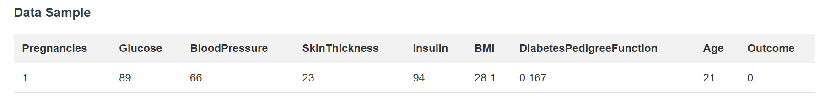
DATA OVERVIEW
Dataset Summary
Number of Rows: 768
Number of Columns: 9
Features: Pregnancies, Glucose, BloodPressure, SkinThickness, Insulin, BMI, DiabetesPedigreeFunction, Age
Target Variable: Outcome (0 = not diabetic, 1 = diabetic)

Slide 5


DATA PREPROCESSING
Data Cleaning
Handled missing values by imputing median values
Removed any duplicate records
Detected and addressed outliers in features like Glucose and BloodPressure
Feature Engineering
Created a 'BMI Category' feature to group BMI values
Binned the 'Age' feature into ranges
Feature Selection
Performed correlation analysis to identify and remove redundant features
Conducted univariate analysis to confirm the significance of each feature in predicting diabetes risk

Slide 6
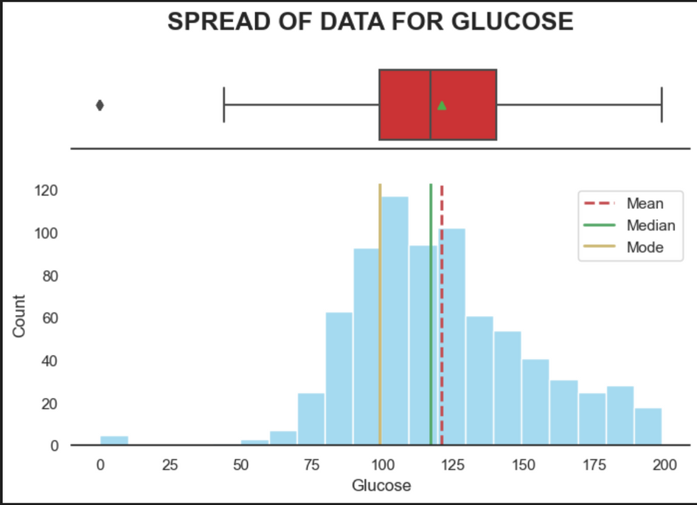
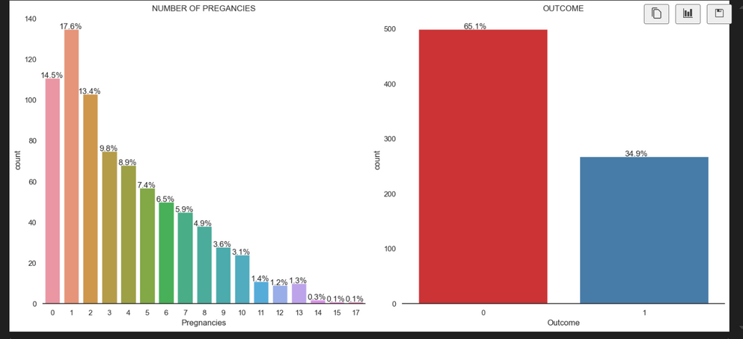
EXPLORATORY DATA ANALYSIS (EDA)
Insights
Glucose levels have a positive relationship with the target variable 'Outcome'
Age and BMI also appear to be important factors in predicting diabetes risk
Some features, such as Glucose and BloodPressure, exhibit skewed distributions

Slide 7

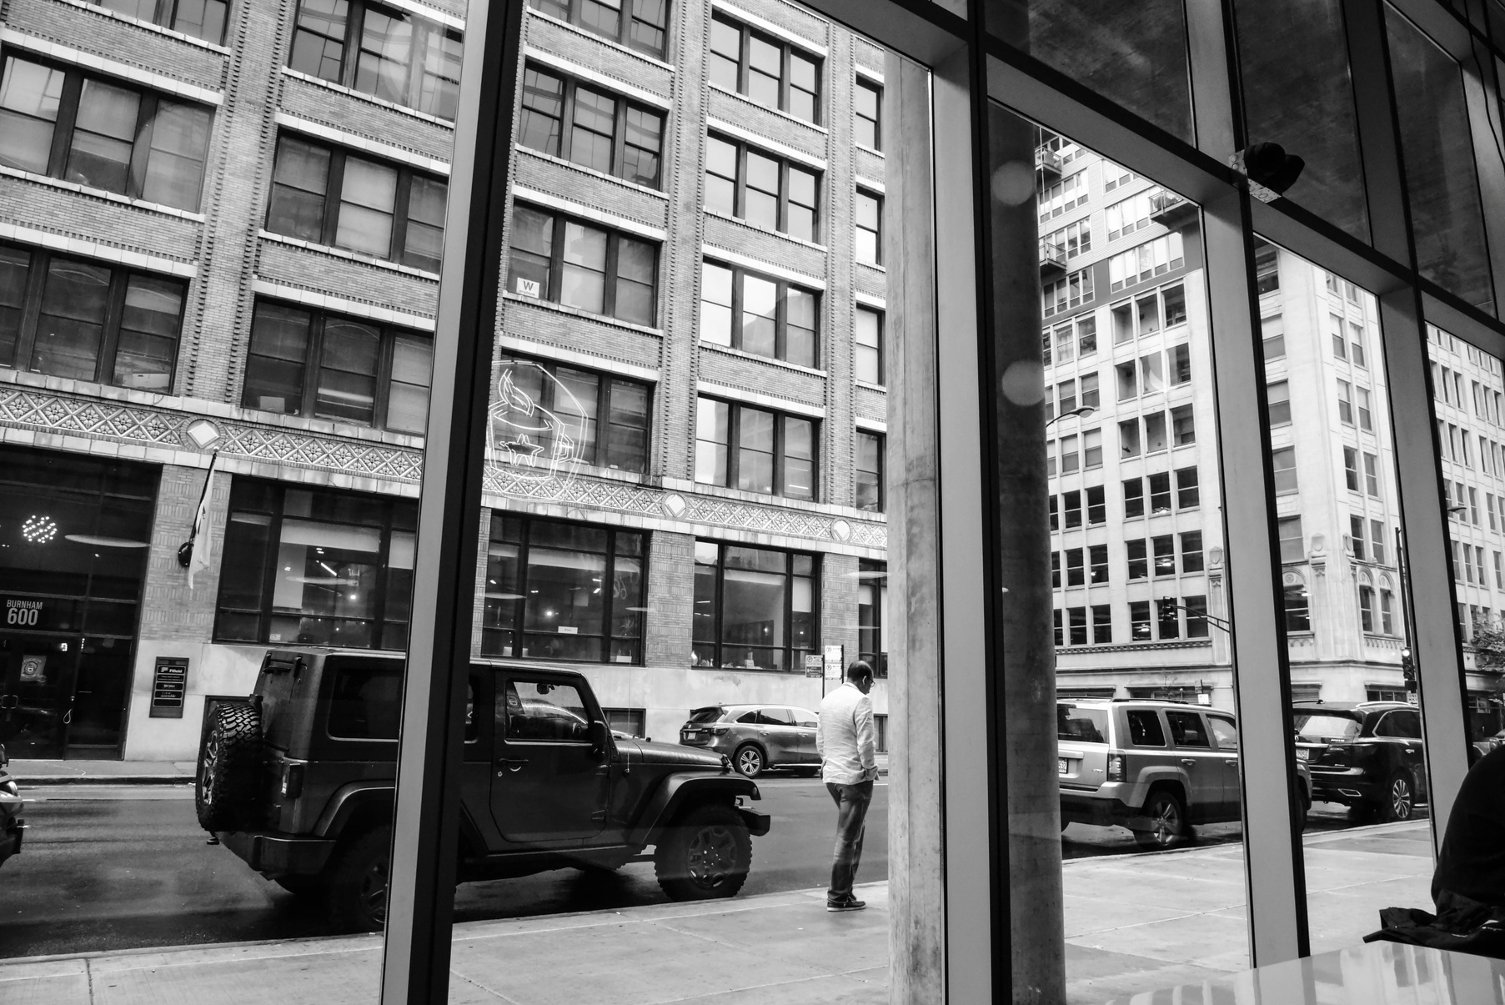
MODELING APPROACH
Model Selection
A Decision Tree Classifier was chosen for this classification problem. Decision Trees are capable of handling both numerical and categorical features, and they provide interpretable results, making them a suitable choice for this healthcare-related task.
Training and Validation
The dataset was split into training and test sets, with around 70-80% of the data used for training and the remaining 20-30% for testing. This approach ensures an unbiased evaluation of the model's performance.
Hyperparameter Tuning
To address the issue of overfitting, hyperparameter tuning was performed using a grid search approach. The key hyperparameters adjusted were 'max_depth' and 'min_samples_leaf', which helped to improve the model's generalization ability.

Slide 8
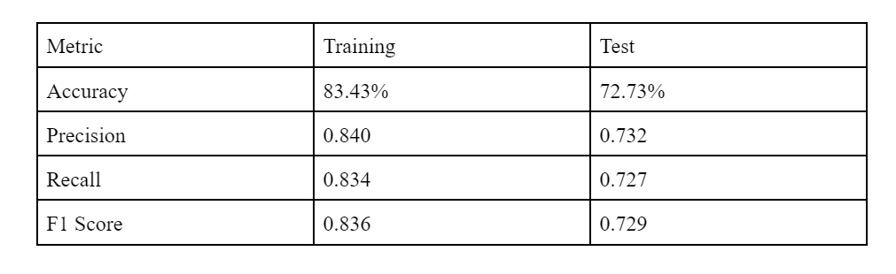
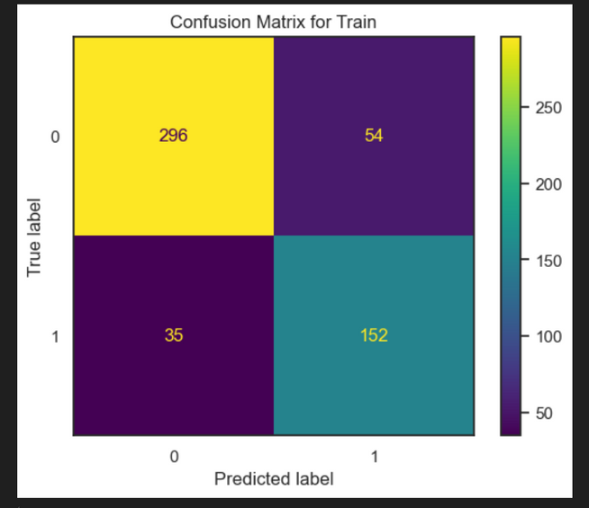
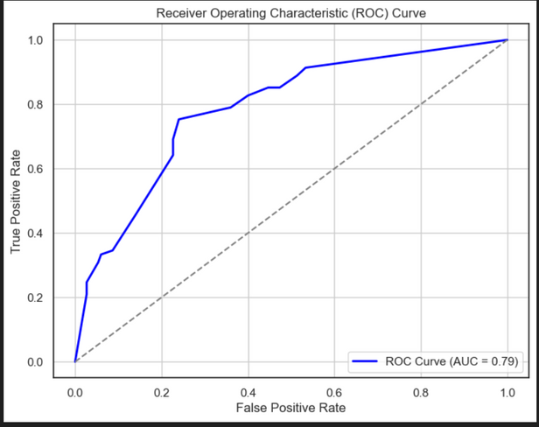
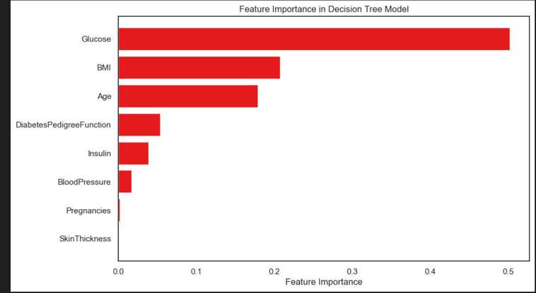
MODEL PERFORMANCE

Slide 9

KEY FINDINGS AND INTERPRETATION
Main Results
Glucose, Age, and BMI are the most significant factors in predicting diabetes risk, with Glucose being the most influential feature
The Decision Tree model was able to categorize individuals into Lower Risk and Higher Risk profiles based on these features, although it struggled when Age or BMI played a more critical role than Glucose levels
Practical Implications
These findings can help healthcare providers and businesses in the health sector target at-risk populations, particularly among middle-aged and overweight women. Early identification of high-risk patients could lead to timely interventions, reducing the long-term impact of diabetes and associated healthcare costs.

Slide 10
CONCLUSION AND FUTURE WORK
Summary
This project successfully identified key factors, including Glucose, Age, and BMI, that contribute to predicting diabetes risk, with Glucose being the most influential feature. The Decision Tree model, after hyperparameter tuning, improved its generalization ability, but faced challenges in cases where Age or BMI played a more significant role than Glucose.
Future Improvements
Explore more advanced models, such as Random Forest or Gradient Boosting, to improve performance
Enhance feature engineering to better capture the relationships between variables and address misclassifications
Expand the dataset to improve model generalization across different populations
Conduct further hyperparameter tuning to optimize the model's ability to balance precision and recall

Slide 11
THANK YOU

